Slide 1
The Planetary Data System and “PDS Challenge”
Ed Grayzeck/Todd King
February 4, 2016

Slide 2
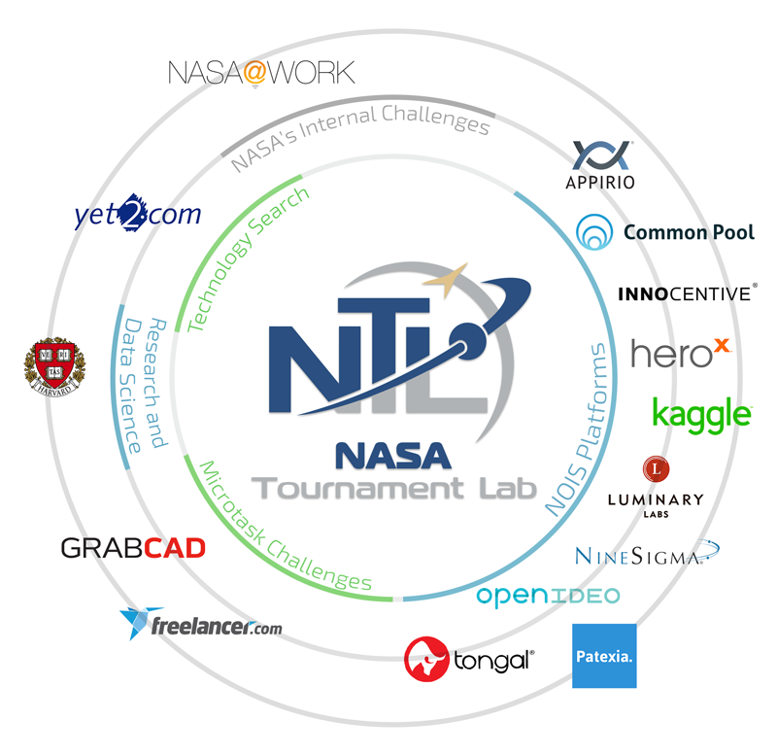
NASA’s Tournament Lab (NTL)
Facilitates the use of crowdsourcing to tackle NASA challenges.
Seeks novel ideas or solutions to accelerate research and development efforts, improve algorithm performance, and seek new ideas and approaches in support of the NASA.
Very agile
Best for
Conceptualizing
Design
Prototyping (Proof of concept)

Slide 3
Past NTL interactions
“PDS Challenge” status as of 2016
NASA Tournament Lab(NASA/Harvard/TopCoder) teamed with PSD to implement as NTL action
Contests initially supported by NTL via NASA HEOMD (then CoECI) and through SMD
Used a restricted sample of SBN (comet Halley) -start 2012 and presented at Oct 2012 DPS
Poster at Oct 2013 DPS including step to form Cassini-Rings (C-R)Challenge – workshop/posters
Planetary Data Storyboard abstract at Dec 2015 AGU in NASA SMD special education session
New Task system from CoECI with SMD support for C-R Next Steps

Slide 4
Challenge Cassini - Rings
1. NTL Teams to search Cassini ISS data for disruptions – step 1 contests completed.
2. Step 2 Marathon Match (761 “controls”)
3. Evaluation by Rings (30K images) identifies needed improvements in efficiency of algorithym
4. Work through CoECI multi-phase task order contract with SMD funds
5. Control search leads to promising results but needs robust verification
6. Outline steps to complete phase 1 with improvements and documentation

Slide 5
PPI Challenge and Storybook Update
Todd King, Ed Grayzeck

Slide 6
Storyboard PPI’s First NTL Challenge
History
Concept proposed (11/14)
SMD funding for proof-of-concept (5/15)
Completed (11/15) - http://52.3.187.118:3000/
Key features
Based on Myyna (a Pintrest clone)
Pin web item (pages, pictures, etc.)
Node.js application.
Key drawbacks
Time line view based on time item pinned.
Pinned items can be easily disorganized

Slide 8
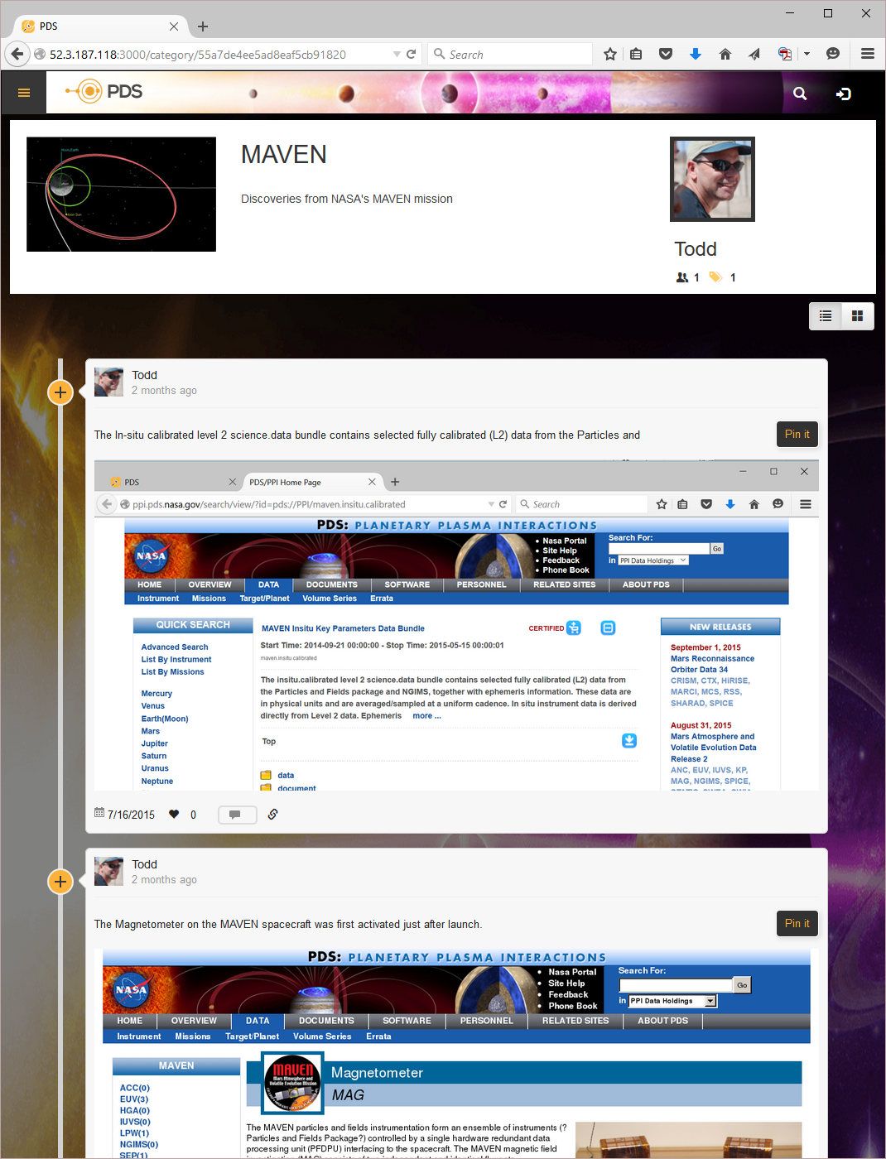
Author
Follow
Timeline
Pinned Item
Like it

Slide 9
We Found That…
Using the NTL and the challenge approach is great for
Tapping into a network of professionals and experts.
And to do:
Conceptual Design
User Interface Design
Proof-of-concept or prototype development.
It’s very agile
small sections with multiple implementations, reviewed and best implementation is selected.

Slide 10
Storyboard – Next Steps
The first version of software is a valuable learning experience.
Re-implementing can result in a more refined application.
This is what we chose to do for the Storyboard.

Slide 11
Storyboard - Revision
Pared down and simplified design.
Development started two weeks ago
completed first phase
Key Features
Meteor application (node.js)
Uses application specification approach (meteor-kitchen)
Two sided timeline
Public and private viewing.

Slide 15
Planned Features
Login using Oauth (Google, Facebook, Github, Linkedin)
Step-by-step feature (education mode)
Image upload (and web page snapshot)
Visual editing of cards and timelines
Search feature
Featured and most popular on home page
User dashboard (views, likes, shares)
Like and share
Team editing
Server deployment

Slide 16
PPI Challenge – Our Goals
Innovate
“The trick to innovating is not coming up with something brand new, but connecting things we've never connected before, pairing different technology together.“
(Sean James, Microsoft)
PDS has an infrastructure – let’s use it!

Slide 17
PPI Challenge – Selecting a topic
Selecting a challenge has been challenging.
Visualization of data
Our in-house development has matured quickly. No need for a challenge.
PDS4 support in Python
An hour after selecting this we got the e-mail from Mike A’Hearn announcing the SBN effort. No need to duplicate.
Selecting an item from Anne’s list.
But we will be funding the challenge with PPI sources and need to meet a direct PPI need.
?

